Slide 1
Gratefulness and Community
Part A

Slide 2
Three examples of what happens
when people live gratefully and generously.
Because generosity leads to gratefulness,
and gratefulness leads to generosity,

Slide 3
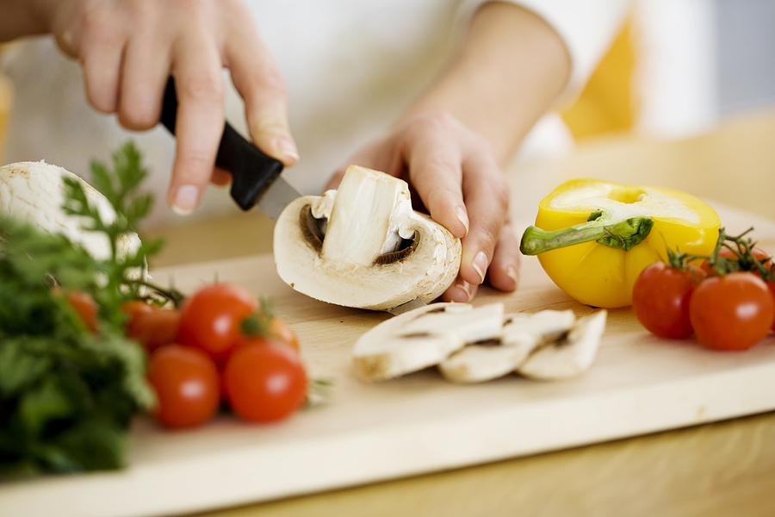
Crisis Kitchen
A model of mutuality

Slide 4
They recognized the food insecurity of their neighbors because of the pandemic and chose to address it with what they were good at, what they could do.
They created high-quality meals, offered their best skills.
It wasn't just an act of charity; it was creating a mutual aid environment.

Slide 5
Farmers donate produce.
Ordinary people donate from their backyard garden.
A church offers their kitchen as part of their ministry.
The refrigerators were donated.

Slide 6
“What I love most about feeding people is that it is an expression of love to people you don't even know.”
“I do this because I have an investment in your well-being that I hope that will lead to your investment in my well-being.”

Slide 7
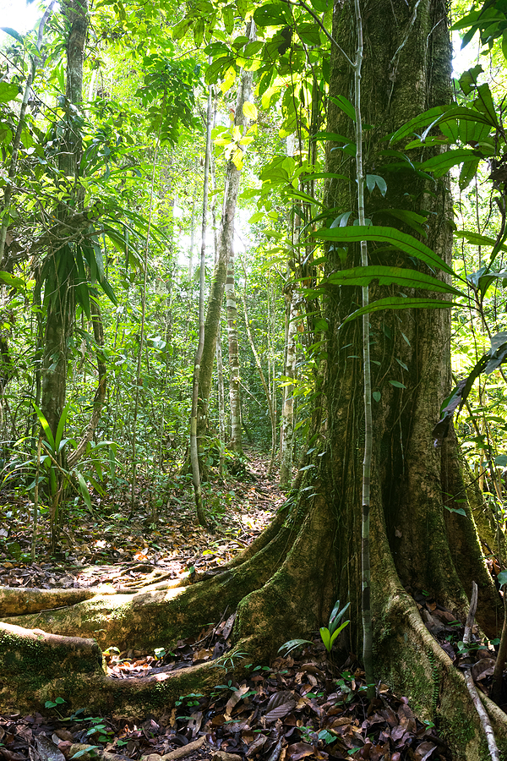
The Amazon Hunter
Lynne Twist is an environmentalist committed to alleviating poverty, ending world hunger and supporting social justice and environmental sustainability.
Often works with the people of the Amazon.

Slide 8
The people of the Amazon are very clear when they have enough of anything. They never take more than they need.
If a hunter kills wild boar in the forest, then that’s a feast for everybody.
It’s not for one family who’s going to hoard it and make sure that it’s put away for a rainy day. Everybody shares.

Slide 9
A sociologist asked a hunter where he stores the leftovers when he kills an animal that is more than he needs.
“I store my meat in the belly of my brother,” he said.

Slide 10
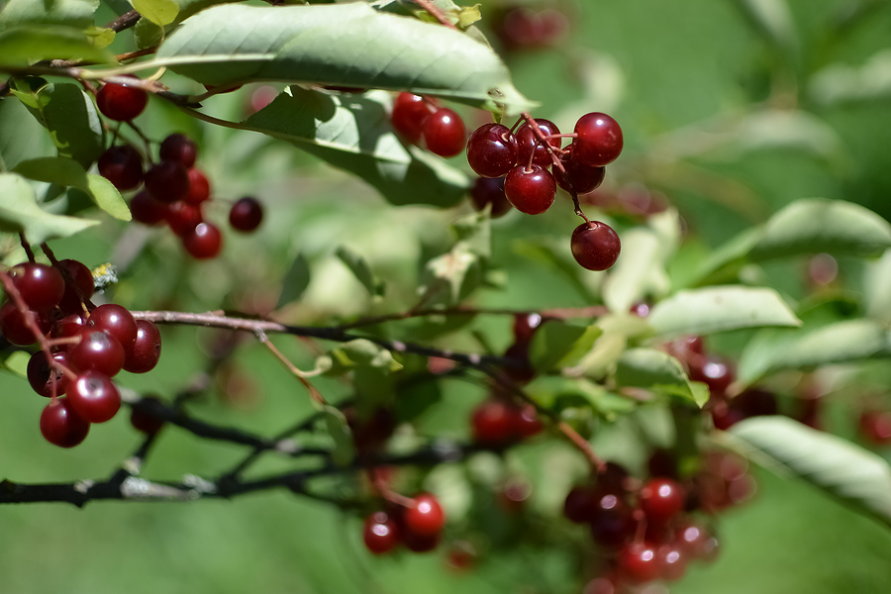
The Serviceberry Tree
Robin Wall Kimmerer is a botanist, a college professor, writer, of Native American heritage.

Slide 11
Picking serviceberries in the field one day she was struck by the gift nature of the tree.
“There is no mathematics of worthiness that reckons that I deserve them.”
“Yet here they are. Along with the air and the sun and the birds and the rain.”

Slide 12
“When we speak of things not as products or commodities but as gifts the whole relationship changes.”
Gratitude is the first response; the second is reciprocity.

Slide 13
The gift begets more gifting.
She takes some berries to her neighbor who bakes a pie and takes the pie to another neighbor who is so grateful he volunteers at the local food pantry.

Slide 14
In a gift economy wealth means having enough to share; the practice for dealing with abundance is to give it away.

Slide 15
Questions for discussion
What do you take away from these stories?
What commonalities do you find in the stories?

